Slide 1

Database Theory and Applications for Biomedical Research and Practice BMIN 502 / EPID 635 Week 8: More database implementation
John H. Holmes, PhD

Slide 2
Agenda
Review MySQL installation
More relational theory
Joins
The data dictionary
Assignment 6, continued
Preparing for the PennOmics class

Slide 3
Relationships between tables
Join
Association between a field in one table and its counterpart in another table
View (or Dynaset)
Sets (virtual tables) created dynamically as the result of joining two or more tables

Slide 4
Types of joins
Equijoin
Records are combined and added to dynaset only when values are equal for the join fields
Left outer join
Records from “left-hand” table are added to dynaset even if none in “right-hand” table match
Right outer join
Records from “right-hand” table are added to dynaset even if none in “left-hand” table match

Slide 5
INNER JOIN (or JOIN)
Patients
Visit
Result of JOIN
SELECT Patients.ID, Visit.VISITDATE
FROM Patients
JOIN Visit on Paitients.ID = Visit.ID

Slide 6
LEFT JOIN
Patients
Visit
Result of LEFT JOIN
SELECT Patients.ID, Visit.VISITDATE
FROM Patients
LEFT JOIN Visit on Paitients.ID = Visit.ID

Slide 7
RIGHT JOIN
Patients
Visit
Result of RIGHT JOIN
SELECT Patients.ID, Visit.VISITDATE
FROM Patients
RIGHT JOIN Visit on Paitients.ID = Visit.ID

Slide 8
You can create a view with a join…
CREATE OR REPLACE VIEW `patient_list` AS
SELECT demographics.subject_id AS demo_subject_id, demographics.dob,
admission.subject_id AS adm_subject_id, admission.adm_date
FROM demographics
JOIN admission ON demographics.subject_id = admission.subject_id
Note that we need to rename the PKs here, using the AS statement.
This is because the view is a virtual table that represents the join,
and you would have two subject_id fields in that view.
Renaming them to represent the table the PKs belong to is the way to get around this constraint
Duplicate PKs are not allowed in any tables!!

Slide 9
The Data Dictionary

Slide 10
Data Dictionaries
“Metadata”
Repository of attributes characterizing all elements in a database
Primary external documentation for a database system

Slide 11
Common data dictionary contents
Table
Field name
Type
Description
Length (optional)
Coding information

Slide 12
Implementing the data dictionary
Word processing document
Low budget, low tech
Difficult to manipulate (sort, reporting, etc.)
Difficult to upgrade
Database
Low budget, high tech
Versatile for sorting and reporting
Easy to upgrade

Slide 13
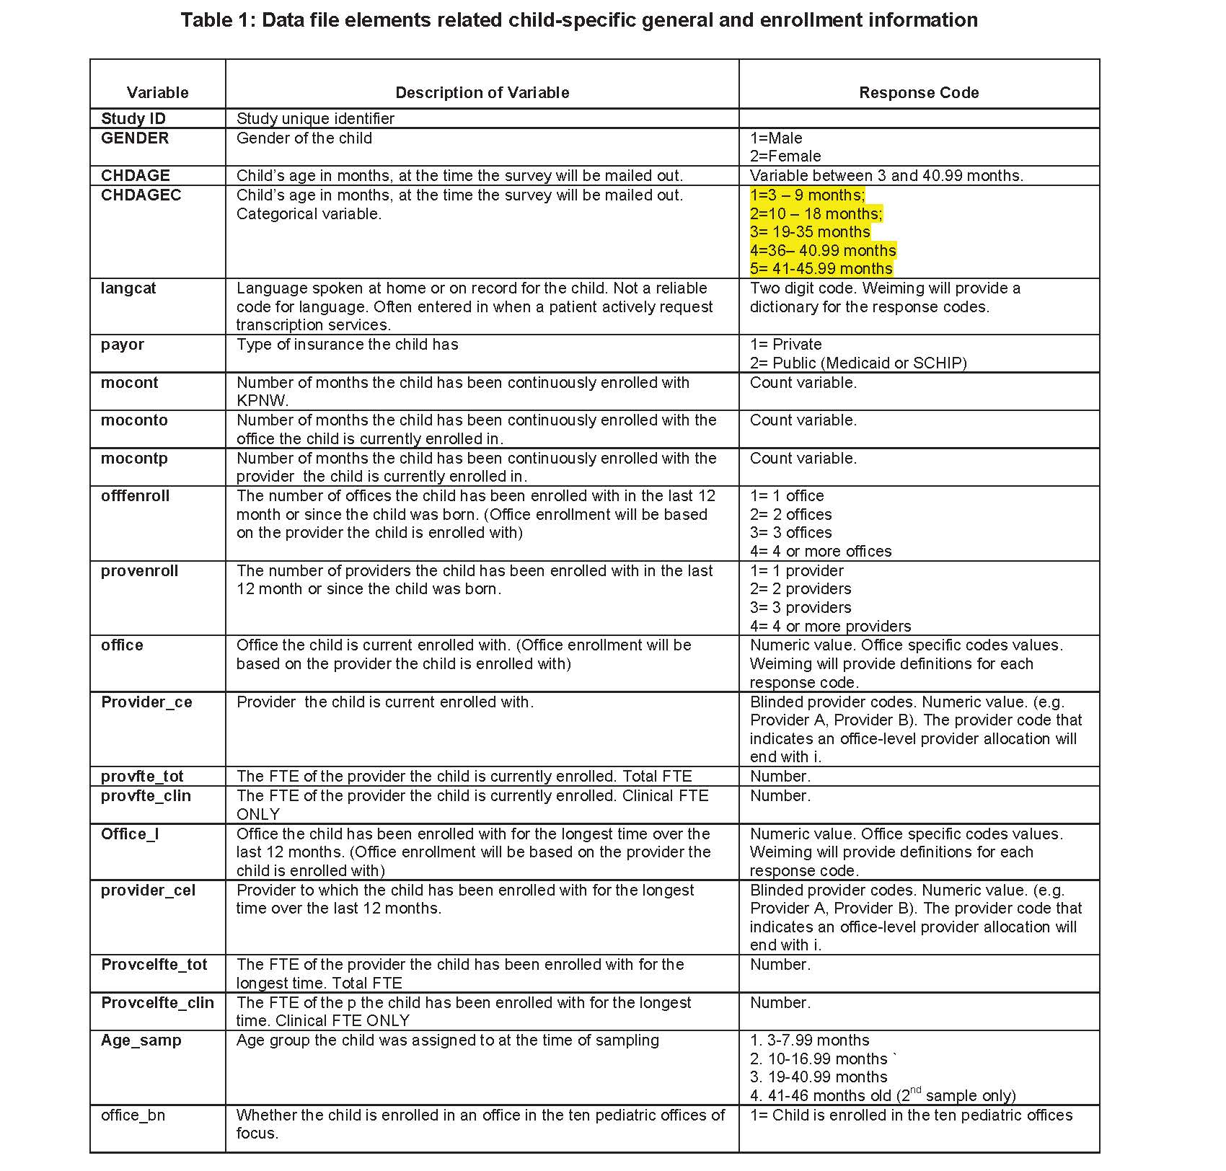
Example DD http://www.commonwealthfund.org/usr_doc/App7_SupplementalVariablesDataDictionary.pdf

Slide 14
There’s SQL code to create this!
select t.table_schema as abic,
t.table_name,
(case when t.table_type = 'BASE TABLE' then 'table'
when t.table_type = 'VIEW' then 'view'
else t.table_type
end) as table_type,
c.column_name,
c.column_type,
c.column_key,
c.is_nullable,
c.column_comment
from information_schema.tables as t
inner join information_schema.columns as c on t.table_name = c.table_name and t.table_schema = c.table_schema where t.table_type in('base table', 'view') and t.table_schema like '%'
order by t.table_schema, t.table_name, c.ordinal_position
Note that the schema is
referenced here by name!
You can save the result
as a .csv file that you can then edit to add coding information.

